Slide 2
Enhanced WebAssign
PRESENTER
Getting Started
[First & Last Name]
[Title]
WebAssign® is a registered trademark of Advanced Instructional Systems, Inc.

Slide 3
Enhanced WebAssign helps students learn, not just do homework.
Unlike homework systems that depend on memorization, Enhanced WebAssign’s educational technology engages instead of drills to elevate thinking and foster a deeper understanding of course concepts to support online math homework, physics homework, and astronomy homework.

Slide 4
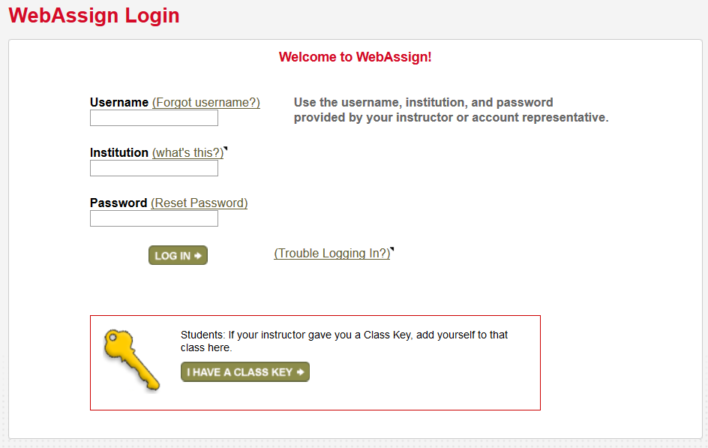
Register/Log In
A. Visit: http://webassign.net/login.html
B. Enter the username, institution code and password provided by your instructor or Learning Consultant OR, if you have one, enter your Class Key.
A
http://webassign.net/login.html
B
B

Slide 5
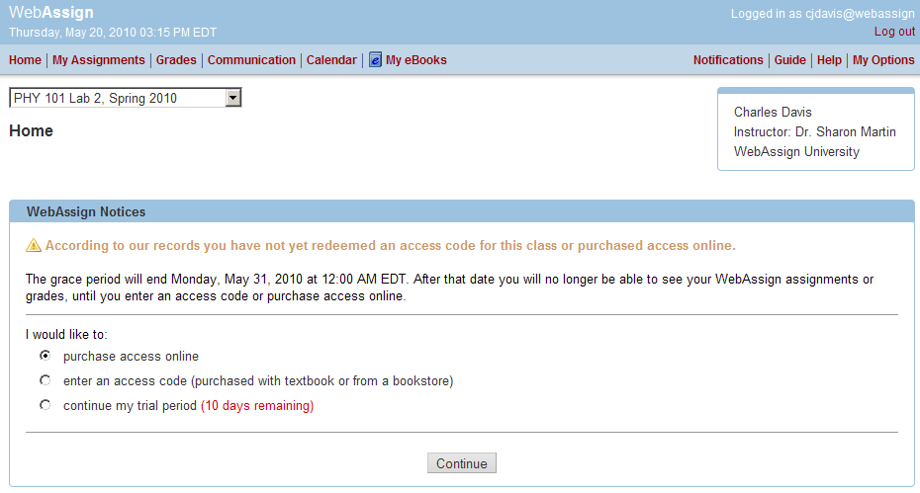
Purchase Access
After logging in, you will see a notice that shows payment options:
A. If you do not have an access code card: Purchase access online!
B. If you have an access code card: Enter your access code!
You can also enter the course under a trial period. After the trial period ends, you must enter an access code to continue working assignments and accessing your grades.
Access Code Card
A
B
Notes:
Your course materials can be purchased at your campus bookstore or by visiting www.cengagebrain.com and searching for your course materials by ISBN.

Slide 6
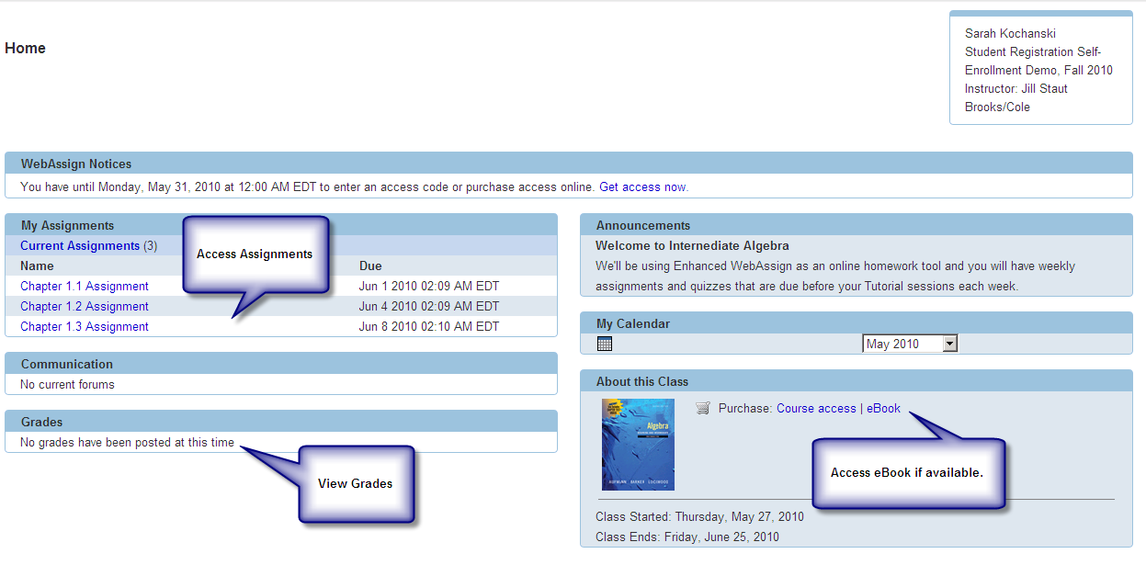
You’re All Set!
That’s it! You’ve successfully registered for Enhanced WebAssign!
The courses that have been set up for you by your instructor(s) appear on your Enhanced WebAssign personalized Home page.
If you have more than one course, simply select the course you want to work with from the pull-down menu.
9
Notes:
9. Click Open next to the name of your course.
That’s it! You’ve successfully registered for Enhanced WebAssign.

Slide 7
Have questions about your Enhanced WebAssign account?
Online:
Visit www.webassign.net/user_support/student/
Email:
student_help@webassign.net
Phone Support:
Toll free: (800) 955-8275
Local: (919) 829-8181
Monday through Friday: 9am–10pm ET
Sunday: 11am–8pm ET
Questions?
We’re Here to Help!
24/7 live chat!
www.cengage.com/support
Sign in using your CengageBrain credentials and create a case.
Once your case is submitted, you’ll receive access to 24/7 live chat! Or you can speak with an agent by calling the phone number provided upon your case submission.
Notes:
If you have any further questions regarding Enhanced WebAssign please contact us using the information shown here.

