Slide 1
Polyhedra
STEM Cats

Slide 2
Tessellations

Slide 8
M.C. Escher

Slide 9
Buckminsterfullerene

Slide 10
Common Cold Virus

Slide 11
Bogota Sport Center

Slide 12
Epcot

Slide 13
Dice

Slide 14
Seven Days Sci Fi TV Series

Slide 15
Rubies

Slide 16
Giant’s Causeway

Slide 17
Origami

Slide 18
Lamps

Slide 19
Projection of Cube

Slide 20
Projection of a Hypercube

Slide 21
Projection of a Hypercube

Slide 22
Many Hypercubes

Slide 23
Delete Half of the Edges to get Diamond

Slide 24
Challenge #1
Construct as many tessellations as you can with identical regular polygons

Slide 25
Challenge #2
Construct as many tessellations as you can with the following properties
All tiles are regular polygons
There are at least two different kinds of tiles
The same sequence of tiles meets around each vertex

Slide 26
Challenge #3
Construct as many polyhedra that you can with the following properties
All faces are equilateral triangles
All edges bend “outward”– the polyhedron is convex

Slide 27
Challenge #4
Construct as many polyhedra that you can with the following properties
All faces are identical regular polygons
The same number of faces meet at each vertex (corner)

Slide 28
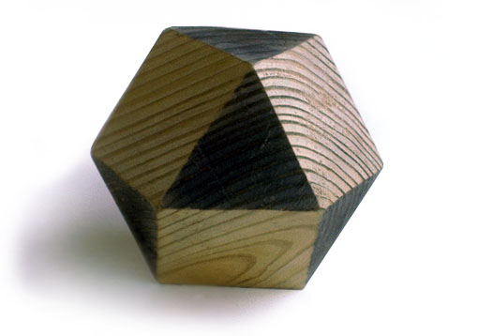
Challenge #5
Construct as many polyhedra that you can with the following properties
All faces are regular polygons
There are at least two different kinds of faces
The same sequence of faces meets around each vertex

Slide 29
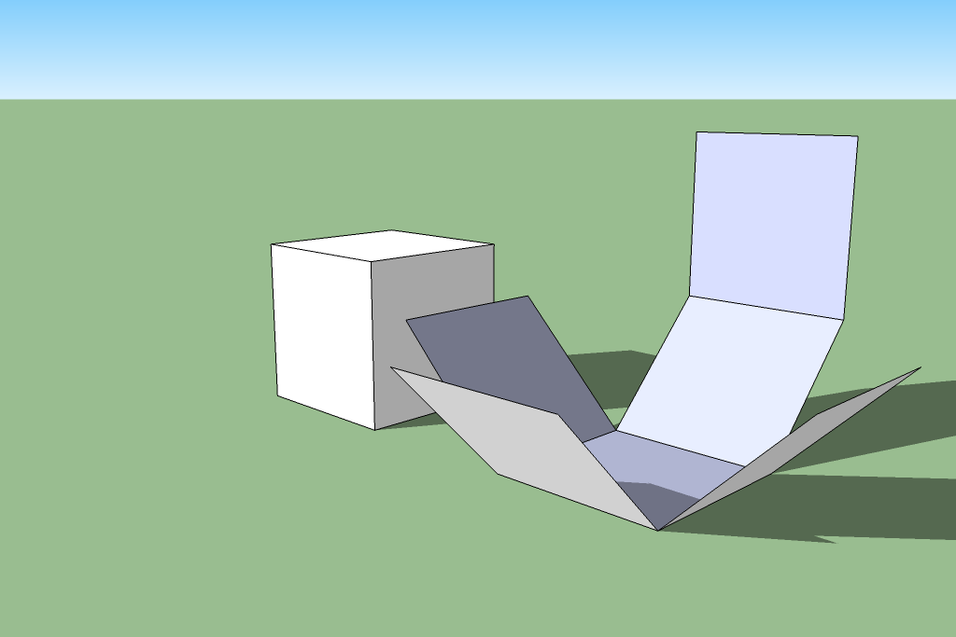
Challenge #6
Find all flat shapes formed by six squares that can be folded up to make a cube.
See also http://erikdemaine.org/metamorphosis/

Slide 30
Image Sources
http://www.georgehart.com/virtual-polyhedra/escher.html
http://it.wikipedia.org/wiki/Fullereni#mediaviewer/File:Fullerene-C60.png
http://www.lightnessofbeingbook.com/LOBColorPlates/images/Plate03b_IcosVirus.jpg
http://www.domusweb.it/en/architecture/2012/01/04/el-bosque-de-la-esperanza.html
http://images.frpgames.org/products/product_36488.jpg
http://i1.sell.com/u/3H/5G/5BQ/4706433-l.jpg
http://images.nationalgeographic.com/wpf/media-live/photos/000/011/cache/rubies_1176_990x742.jpg
http://shearings-cdn2.zolvtravel.com/DynamicImages/d510/d510755c6e739c2465038ddea2f849d0_640_480-634873692367638135.jpg
http://michal.kosmulski.org/origami/icosidodecahedron-jitterbug.jpg
http://media.tumblr.com/tumblr_lefroeVII61qeb9gf.jpg
http://www.jeffreyventrella.com/Old_Art/cuboctahedron_big.jpg
http://www.wdwinfo.com/Photos/600-spaceship-earth3.jpg
http://upload.wikimedia.org/wikipedia/commons/d/d9/Rhombic_dodecahedra.png

