Slide 1
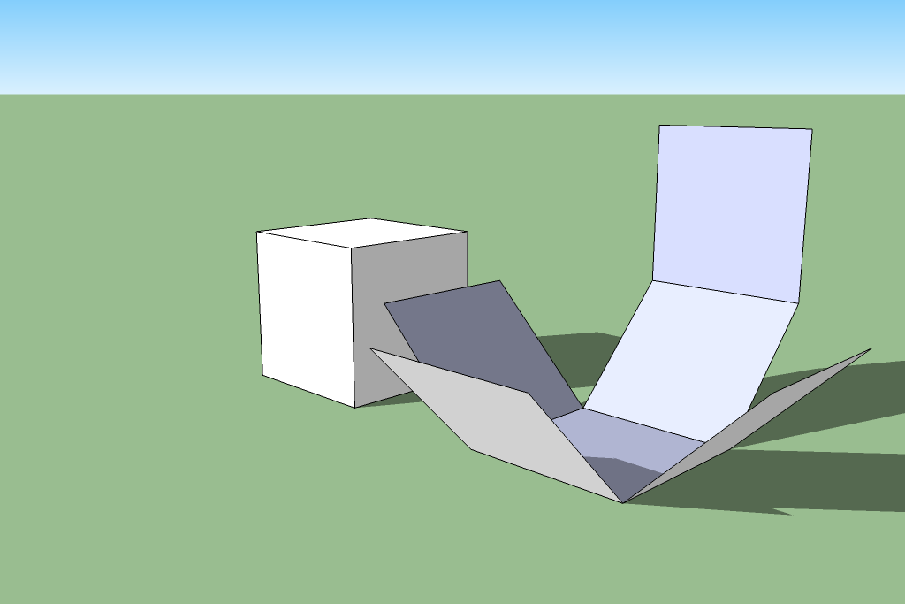
Transformational Geometry Applied Through the Use of SketchUp
Dr. Carl Lee – University of Kentucky
Dr. Craig Schroeder – Fayette County Public Schools

Slide 2
Overview of Project
Integrated STEM Course – 7th Grade
8 weeks, 2-3 days a week
Students had completed instruction on transformational geometry
Students were introduced to SketchUp and were instructed on its various tools
Students created models of current classrooms
Bridge into designing/engineering their own “dream”classroom

Slide 3
Engineering Practices(NGSS)
Defining problems
Developing and using models
Planning and carrying out investigations
Analyzing and interpreting data
Using mathematics and computational thinking
Designing solutions
Engaging in argument from evidence
Obtaining, evaluating, and communicating information

Slide 4
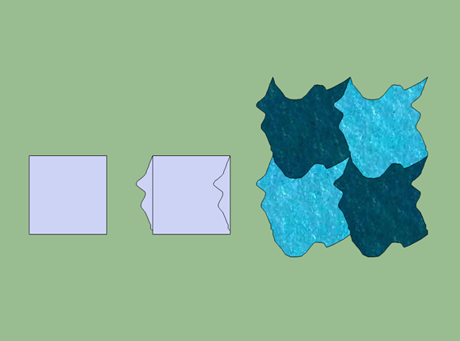
Common Core State Standards—
Transformations
The Common Core State Standards for Mathematics (CCSSM) places a central emphasis on rigid motions and similarity transformations to approach congruence and similarity. Focused encounters with such transformations occur in the middle grades. High school students must then build upon this foundation.

Slide 5
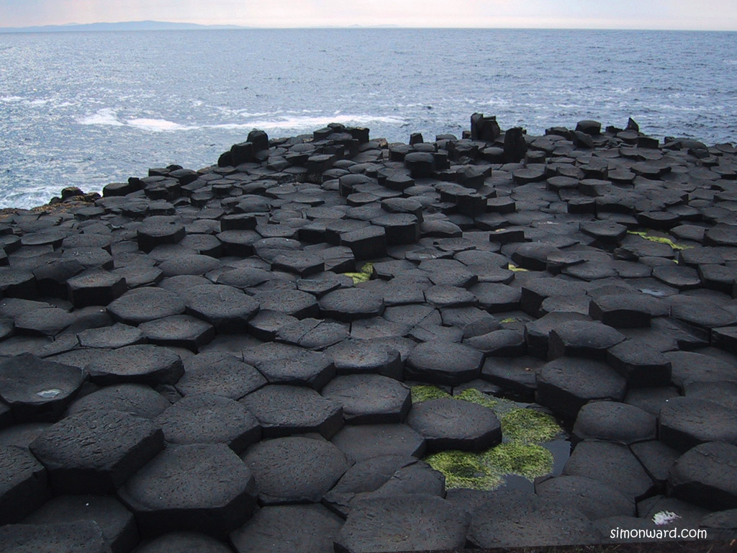
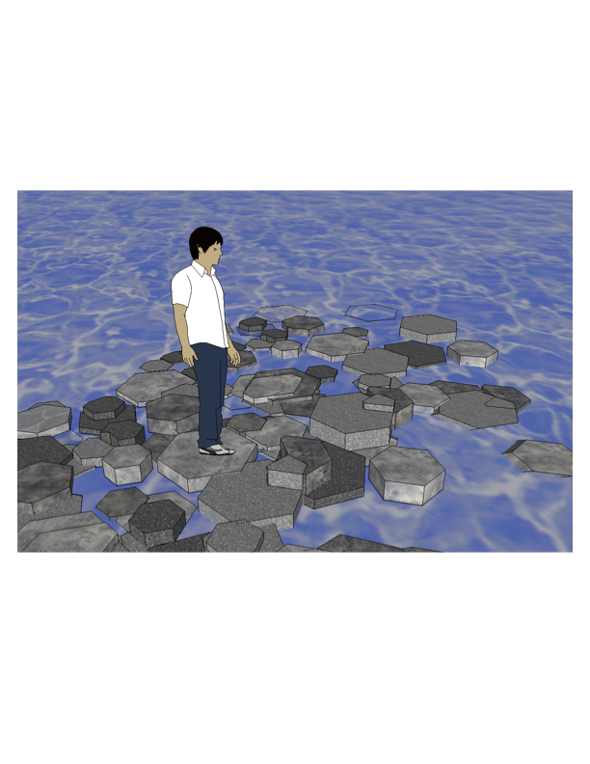
Common Core State Standards—
Modeling
The CCSSM also recognizes the key role of mathematical modeling in the learning of mathematics. It establishes modeling as one of the eight Standards for Mathematical Practice, explicitly weaving appropriate settings for modeling throughout all grade levels.
The process of mathematical modeling rises in prominence at the high school level as a co-equal in value with content courses. The CCSSM states that modeling should be consciously incorporated into all of the courses at this level.

Slide 6
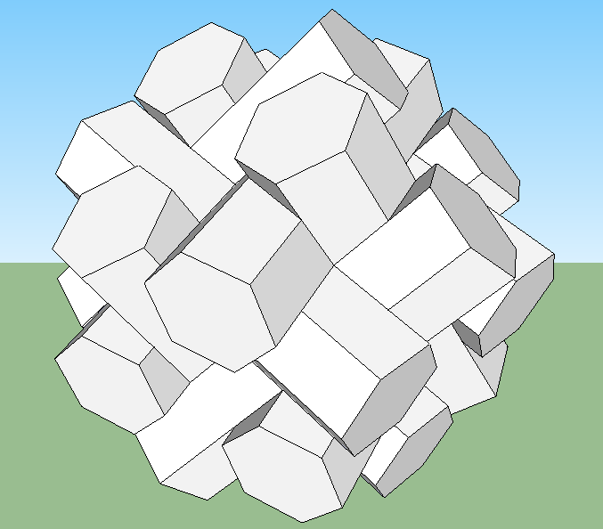
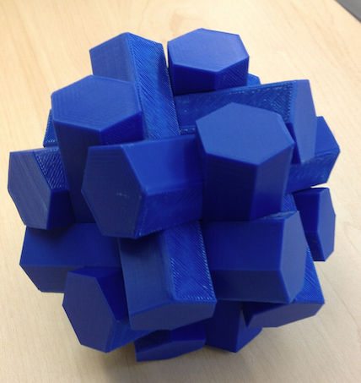
SketchUp Overview
3D geometric modeler powered by a rich set of geometric transformation tools. Freely available from http://www.sketchup.com.
Focused on practical real world design, but also readily lends itself to both 2D and 3D mathematical constructions and explorations. At its heart it is a 3D modeling environment that can be populated by complex shapes created by the user from basic elements through a sequence of transformations or imported from a vast library of pre-constructed models (in the “3D Warehouse”). Offers the option of exporting models in file formats suitable for 3D printing.

Slide 7
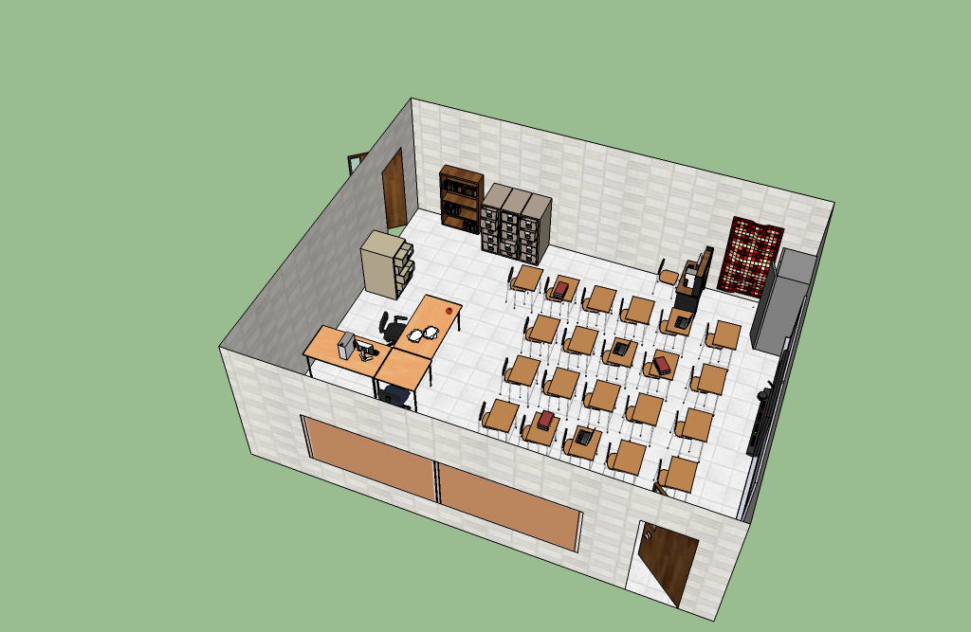
SketchUp Environment
SketchUp operates within a 3D work environment, equipped with a set of axes. The user can use tools such as Orbit, Pan, Zoom, and Walk to change the observer’s viewpoint, even to the extent of entering and moving around in spaces (such as rooms) in the design.

Slide 8
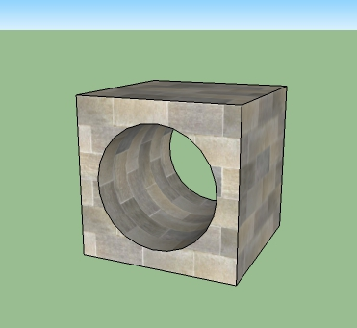
SketchUp Elements
The basic elements of SketchUp are lines and curves, two-dimensional shapes bounded by lines and curves, and three-dimensional objects composed of two-dimensional shapes. The designer can embellish the shapes with various colors and textures.

Slide 9
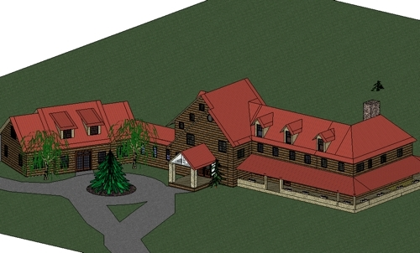
SketchUp Transformations
The real power of SketchUp becomes immediately apparent with its set of transformation tools to construct ever more complicated three-dimensional shapes from simpler elements.
8th Grade final_Nick Bridges2, http://picasaweb.google.com/gallery.sketchup/EducationK12#5340614598792287410

Slide 10
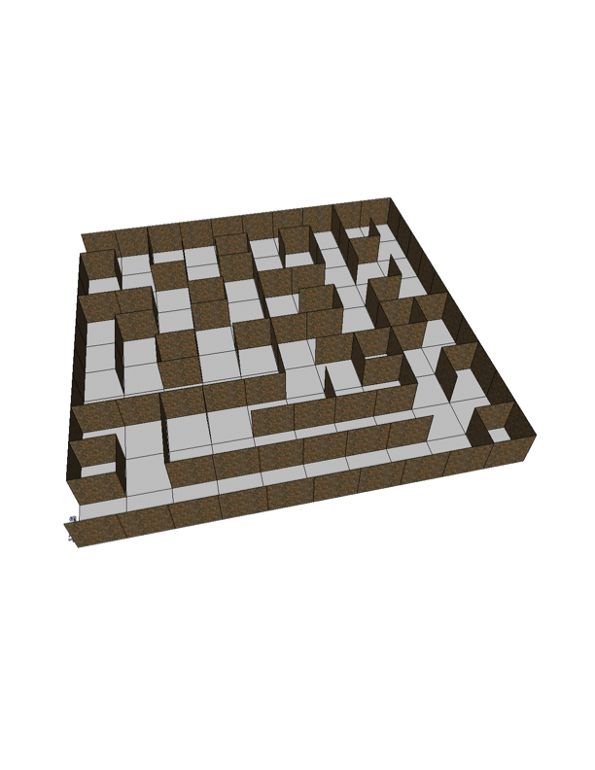
SketchUp Transformations
Translate (Move)

Slide 11
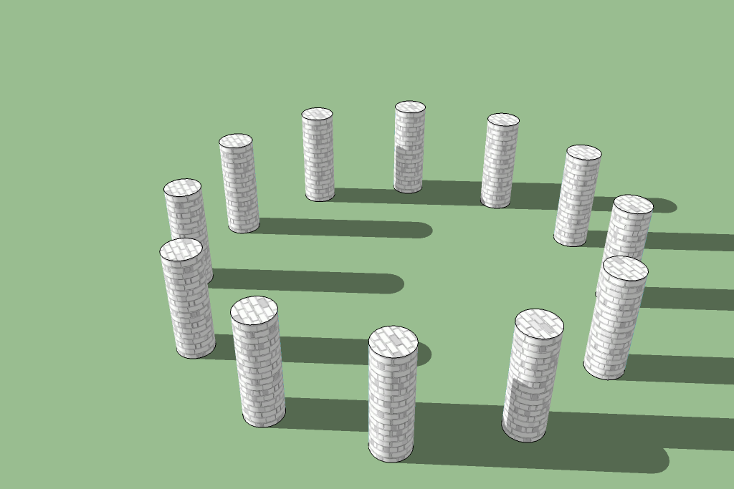
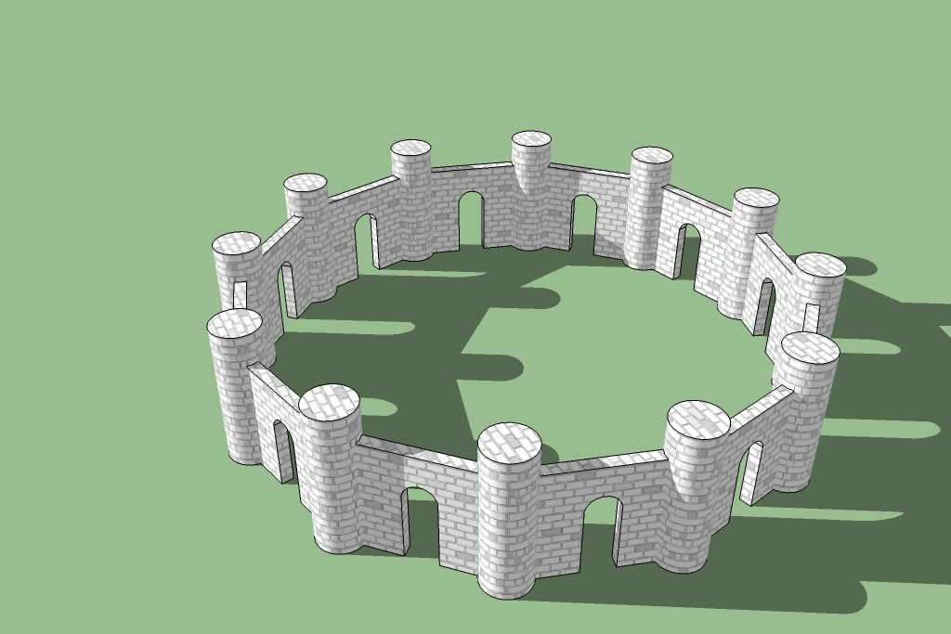
SketchUp Transformations
Rotate

Slide 12
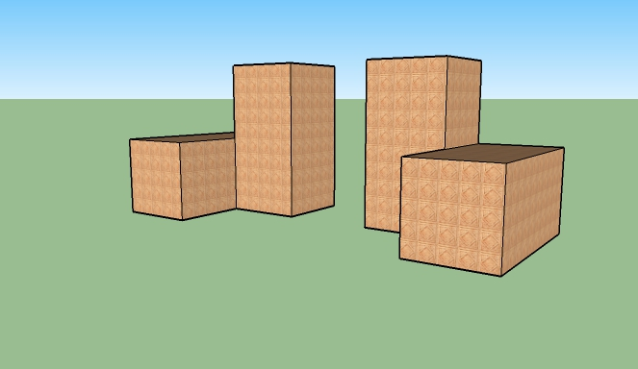
SketchUp Transformations
Reflect

Slide 13
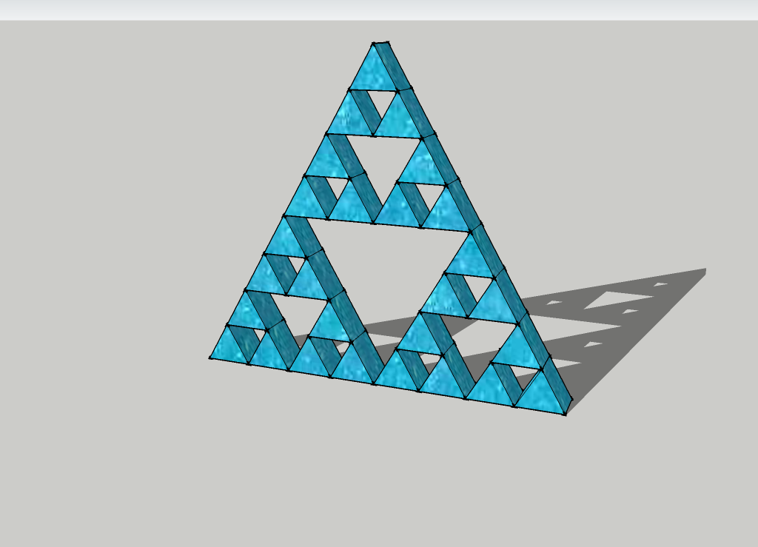
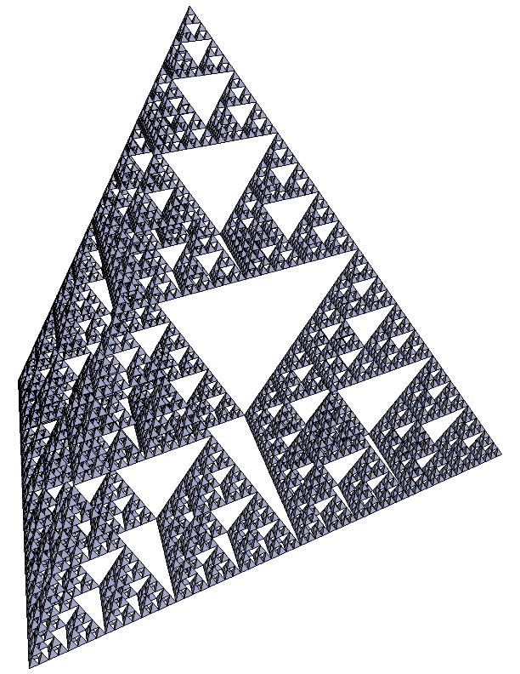
SketchUp Transformations
Scale

Slide 14
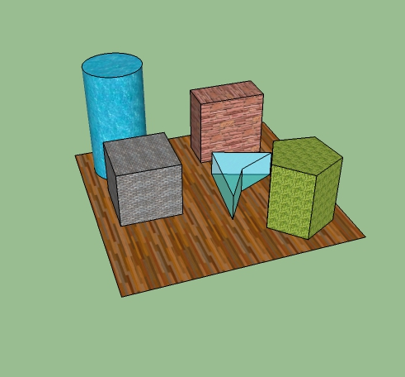
SketchUp Transformations
Prism

Slide 15
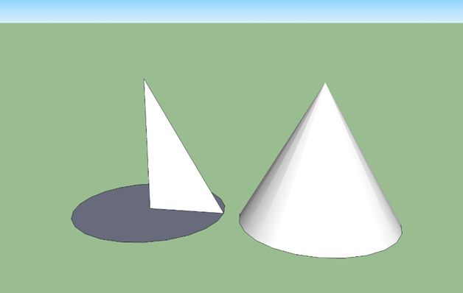
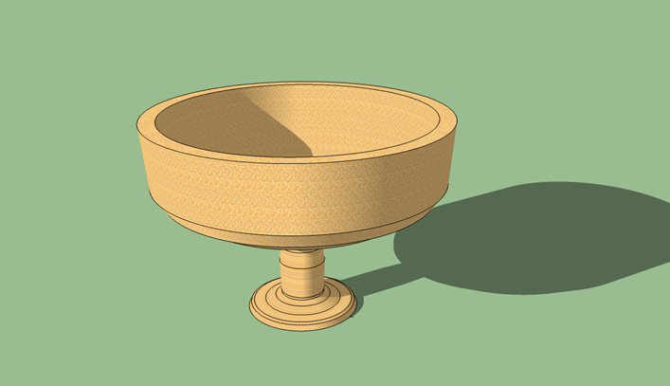

SketchUp Transformations
Extruding a shape along a curve

Slide 16
Middle School Student Projects
Jessie Clark Geometry Project:
http://www.ms.uky.edu/~lee/jessieclark/jessieclark.html
Beaumont Geometry Project:
http://www.ms.uky.edu/~lee/beaumont/beaumont.html

Slide 17
What the students said…What was the design process you used?
  Decide what type of classroom you wish to build (I did an Anatomy/Chemistry room)
  Go to google images for inspiration on other rooms of the same subject
  Collect 2-3 pictures of your liking before making a rough sketch on paper of your room (tables mostly)
  Begin your classroom and add the simple structures
  Research on equipment used in your classroom and either make or add it in ( I had autoclaves, freezers,incubators,microscopes,bacterial shakers ect.) [sic]
  Place equipment and tweak to your liking

Slide 18
What the students said…How would you use SketchUp?
Architectural design
Use it to create an object through the use of a digital net
Model a place described in a literary story
Use to create models for science fair project
Tinker and have fun!
All students reported they would enroll in an elective based solely on SketchUp
All felt confident they could use the program to design their own home

