Slide 1
Polyhedra
Everywhere

Slide 2
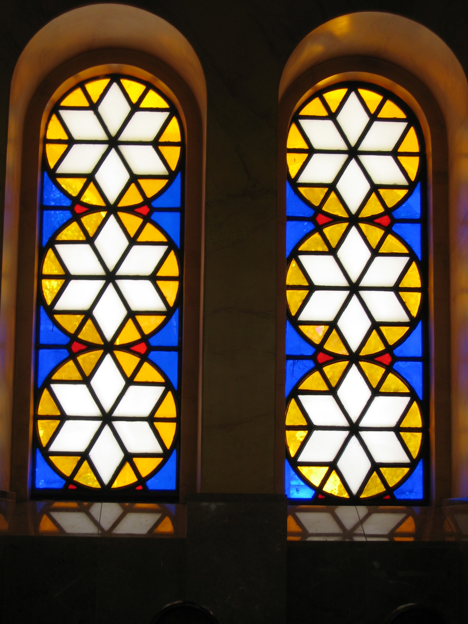
Tessellations

Slide 3
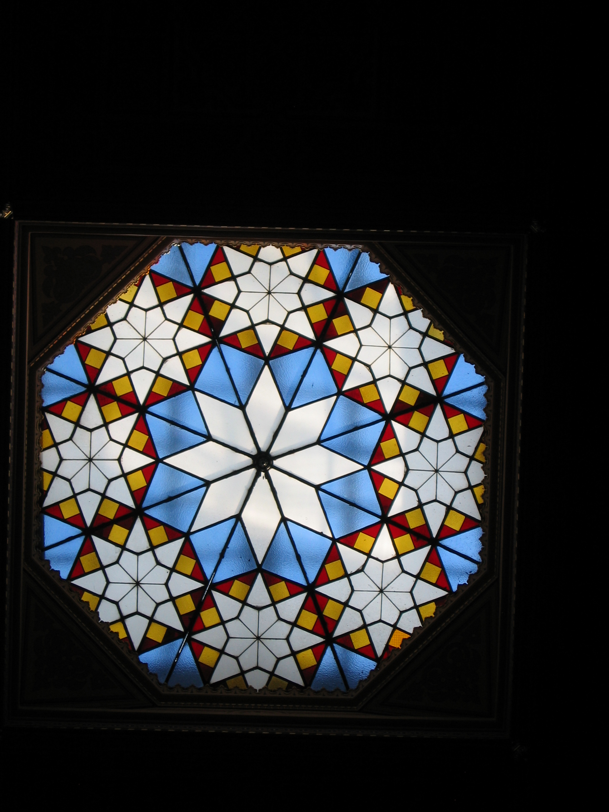

Slide 4
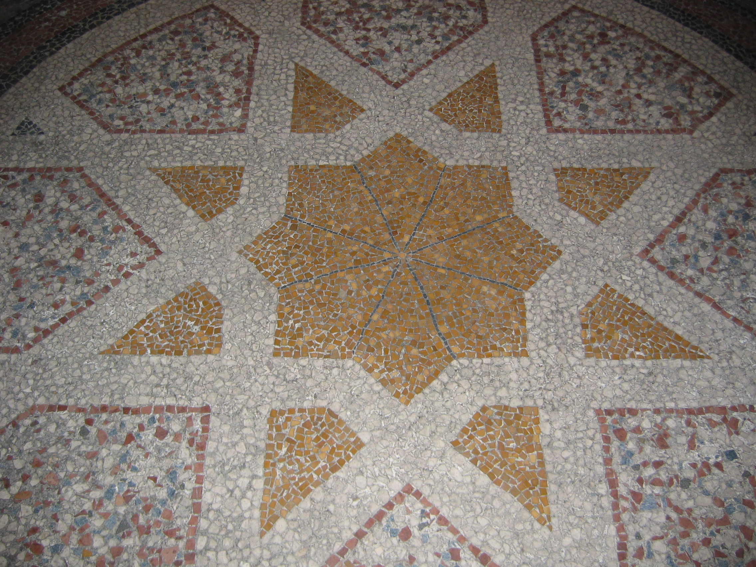

Slide 5
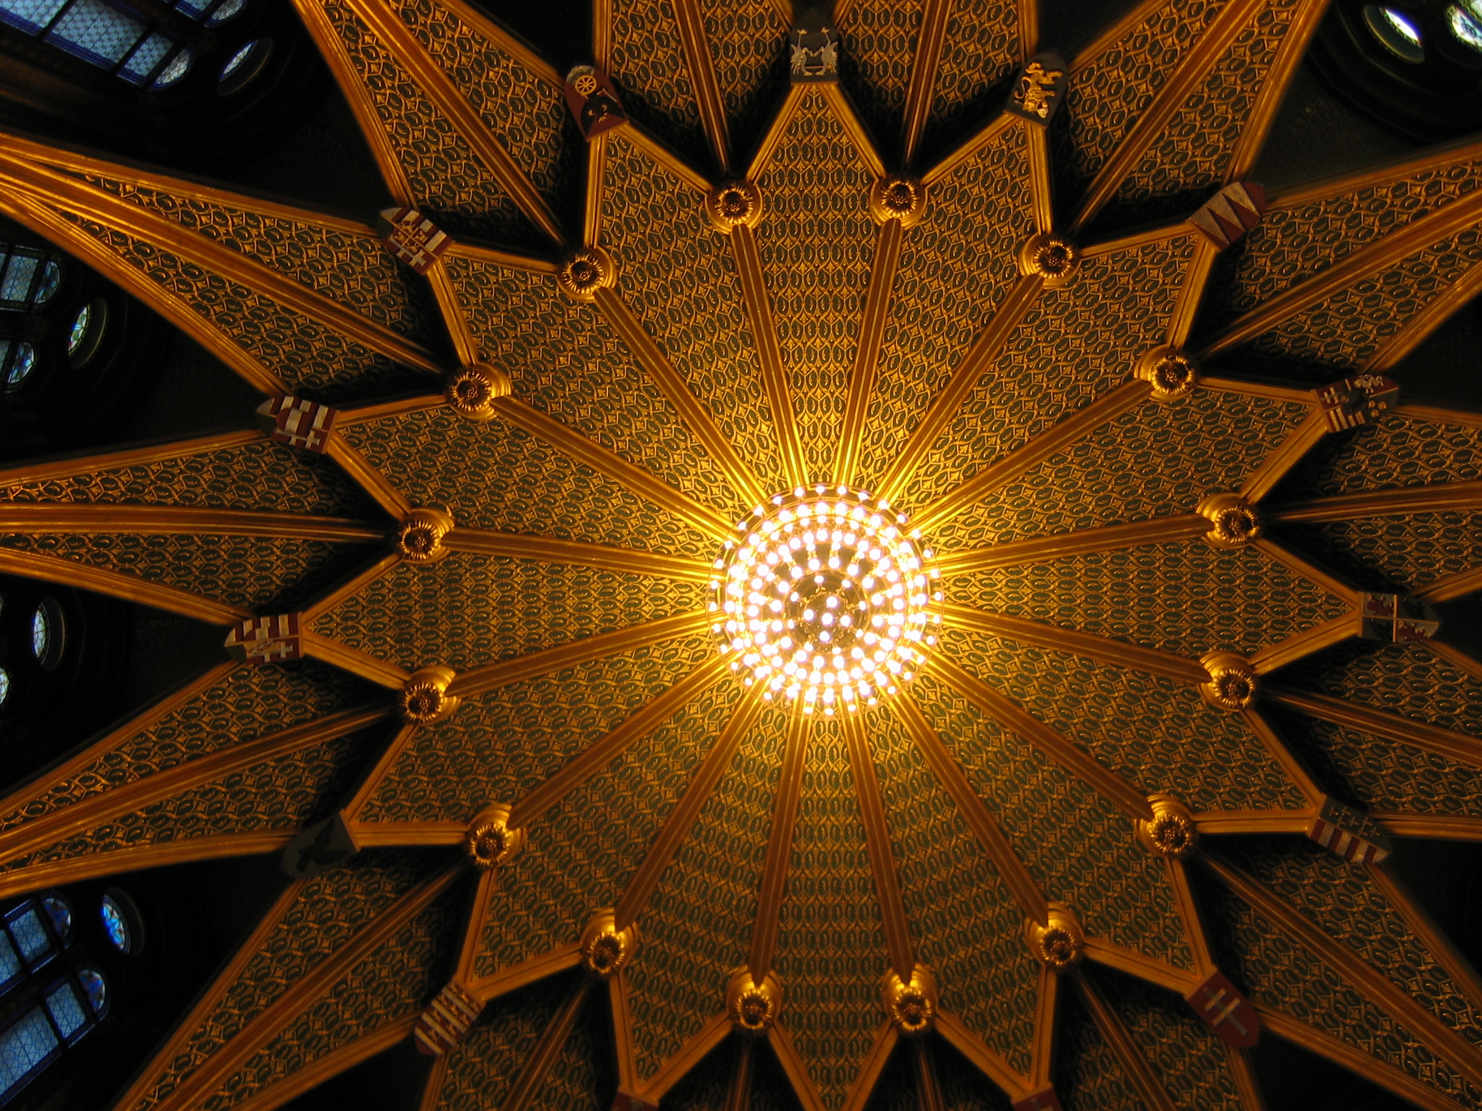

Slide 6
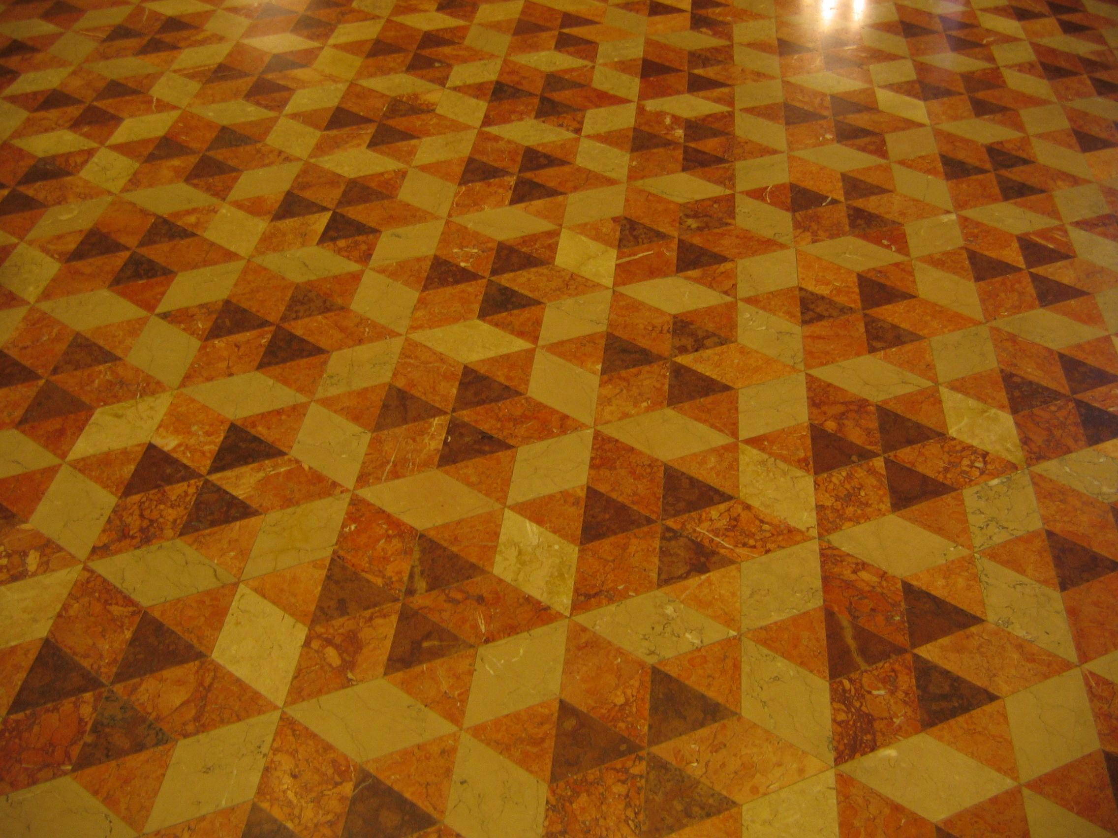

Slide 7
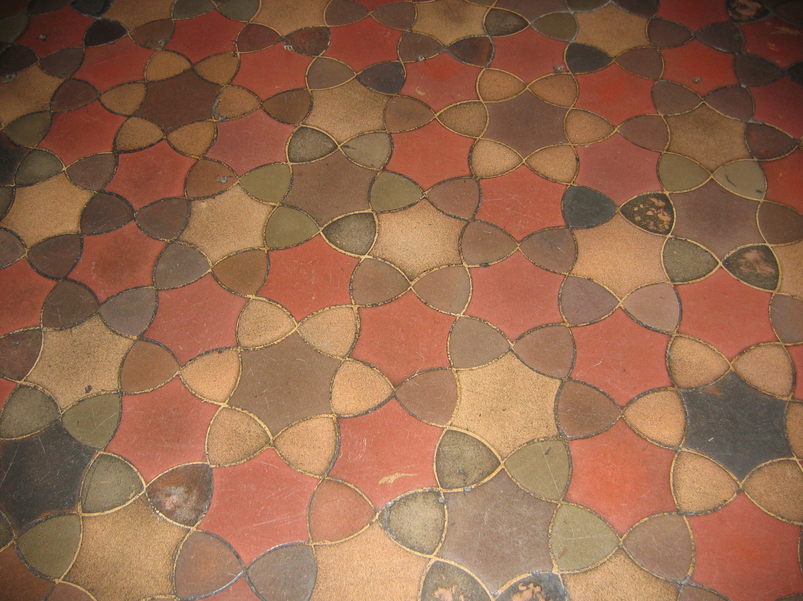

Slide 8
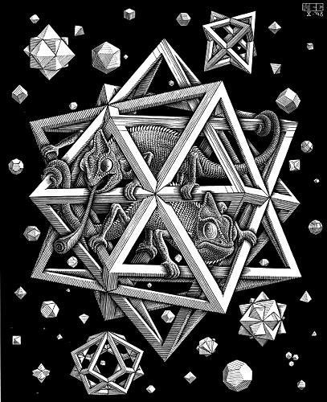
M.C. Escher

Slide 9
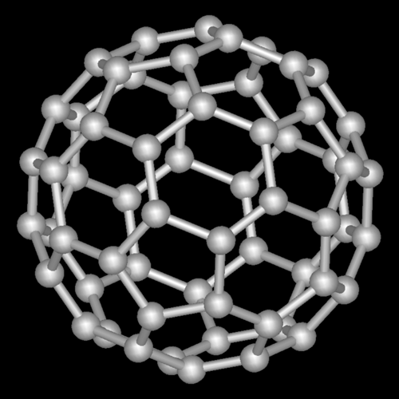
Buckminsterfullerene

Slide 10
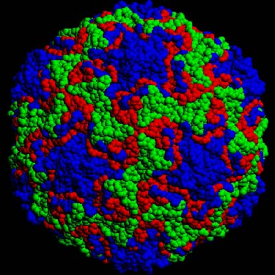
Common Cold Virus

Slide 11
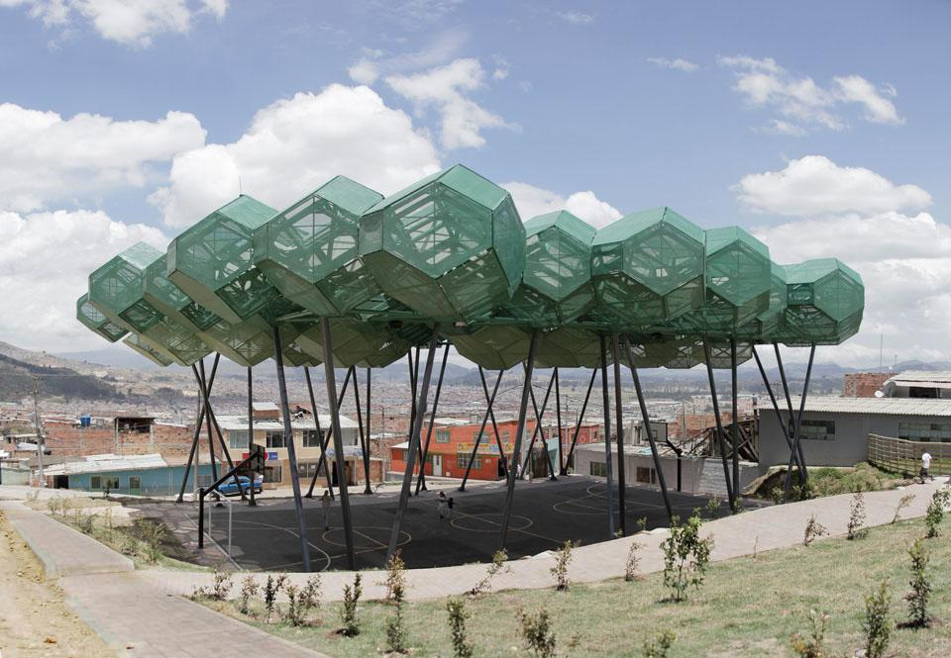
Bogota Sport Center

Slide 12
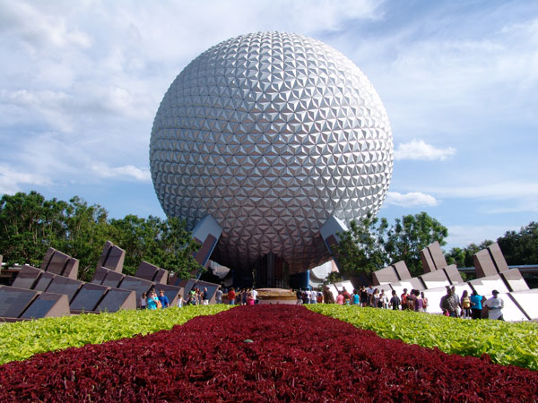
Epcot

Slide 13
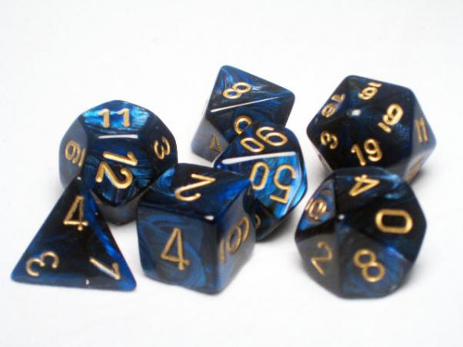
Dice

Slide 14
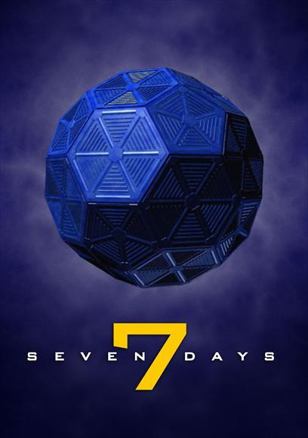
Seven Days
Sci Fi TV Series

Slide 15
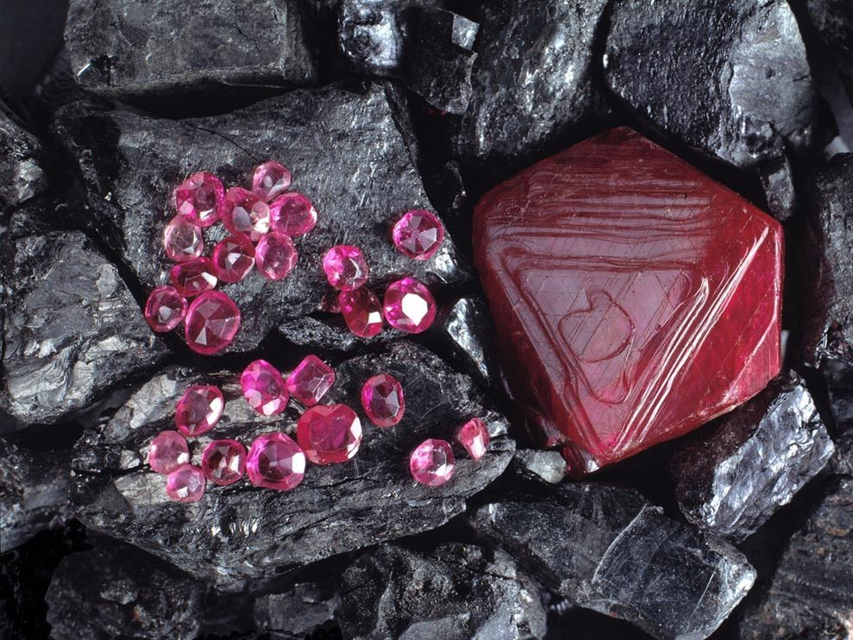
Rubies

Slide 16
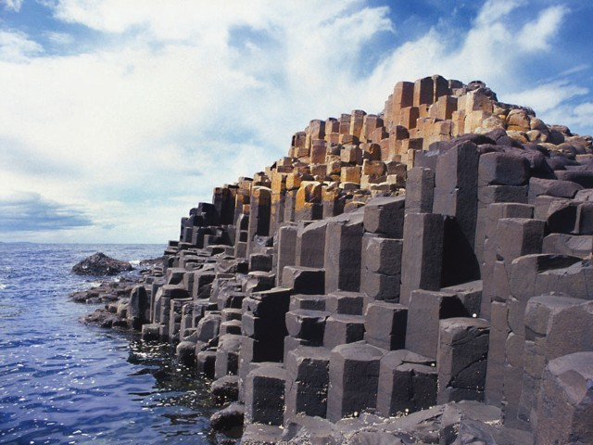
Giant’s Causeway

Slide 17
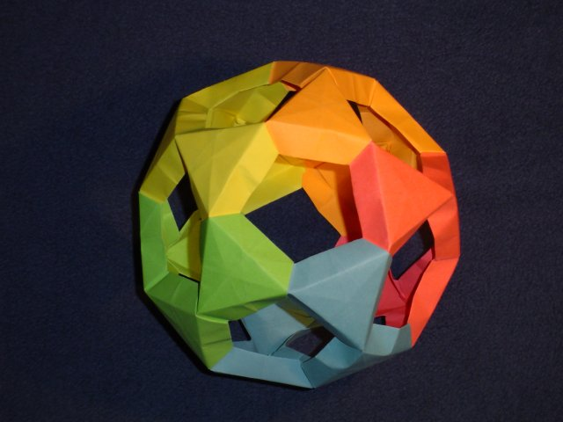
Origami

Slide 18
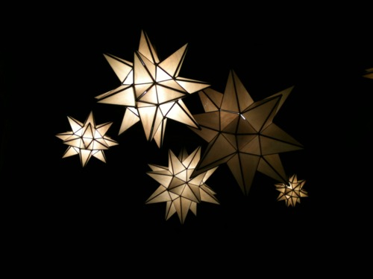
Lamps

Slide 19
Image Sources
http://www.georgehart.com/virtual-polyhedra/escher.html
http://it.wikipedia.org/wiki/Fullereni#mediaviewer/File:Fullerene-C60.png
http://www.lightnessofbeingbook.com/LOBColorPlates/images/Plate03b_IcosVirus.jpg
http://www.domusweb.it/en/architecture/2012/01/04/el-bosque-de-la-esperanza.html
http://images.frpgames.org/products/product_36488.jpg
http://i1.sell.com/u/3H/5G/5BQ/4706433-l.jpg
http://images.nationalgeographic.com/wpf/media-live/photos/000/011/cache/rubies_1176_990x742.jpg
http://shearings-cdn2.zolvtravel.com/DynamicImages/d510/d510755c6e739c2465038ddea2f849d0_640_480-634873692367638135.jpg
http://michal.kosmulski.org/origami/icosidodecahedron-jitterbug.jpg
http://media.tumblr.com/tumblr_lefroeVII61qeb9gf.jpg
http://www.jeffreyventrella.com/Old_Art/cuboctahedron_big.jpg
http://www.wdwinfo.com/Photos/600-spaceship-earth3.jpg
http://upload.wikimedia.org/wikipedia/commons/d/d9/Rhombic_dodecahedra.png

