Slide 1
Comparing Fractions
Tier One Instruction

Slide 2
Tier I Instruction
Tier I is the highly effective, culturally responsive, evidence-based core or universal instruction, provided to all students in the general education classroom. General education teachers implement evidence-based curriculum and/or strategies with fidelity for both academic and behavioral instruction. About eighty percent of students will succeed with evidence-based curriculum, appropriate instructional practices and differentiation to teach academic and behavioral content.
—A GUIDE TO THE KENTUCKY SYSTEM OF INTERVENTIONS

Slide 3
Tier I Instruction
According to research in the field of highly effective instruction, some instructional components to incorporate into a school program include:
Effective classroom discussion, questioning and learning tasks
Focused, descriptive, qualitative, and frequent feedback to students
Clearly defined learning and behavior targets in student-friendly language
Student work/behavior models that meet the learning/behavior target(s)
Critical and creative thinking prompts or questions
Differentiated instruction
Student engagement in self-assessment, self-reflection and peer-analysis based on learning and/or behavior targets

Slide 4
Equivalence and Comparison of Fractions
Essential Understanding 3a
Any rational number can be expressed as a fraction in an infinite number of ways
Source of this and following material: Putting Essential Understanding of Fractions into Practice in Grades in Grades 3–5

Slide 5
Knowledge of Learners
When students are given the opportunity to make sense of problems, they typically approach problem-solving situations in more than one way.
Knowledge of learners involves anticipating possible student responses. However, on some occasions, you are likely to encounter student thinking that is unique or unanticipated.
Collecting different student approaches to mathematics problems over time can help you to plan for future instruction.

Slide 6
Knowledge of Learners
Students may think that if someone gives an answer as an improper fraction, it is incorrect
Students may think that only one fraction can be on a particular “spot” on the number line
Students may think that it is not necessary to refer to the same unit in comparing fractions
Knowledge of student misconceptions, in addition to an understanding of accurate student thinking, can help you to anticipate, address, and challenge your students’ mathematical thinking

Slide 7
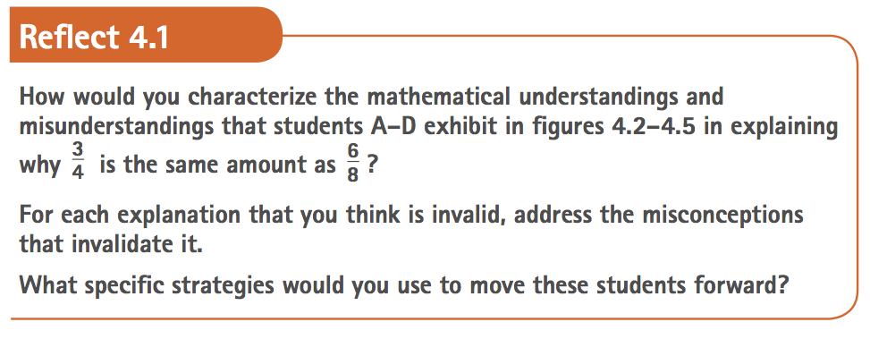
Knowledge of Learners

Slide 8
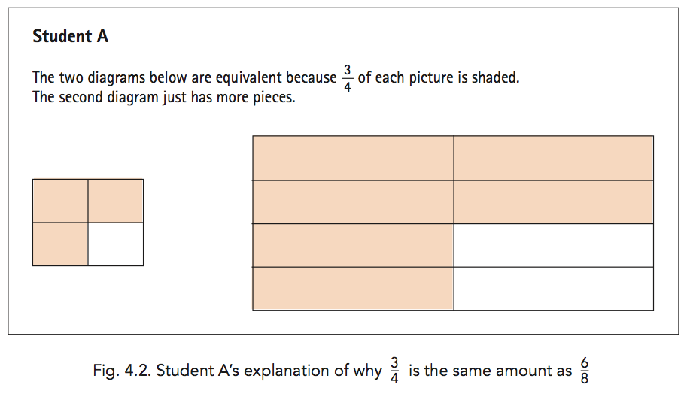
Knowledge of Learners

Slide 9
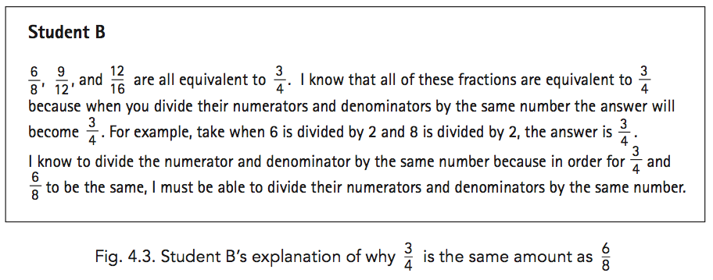
Knowledge of Learners

Slide 10
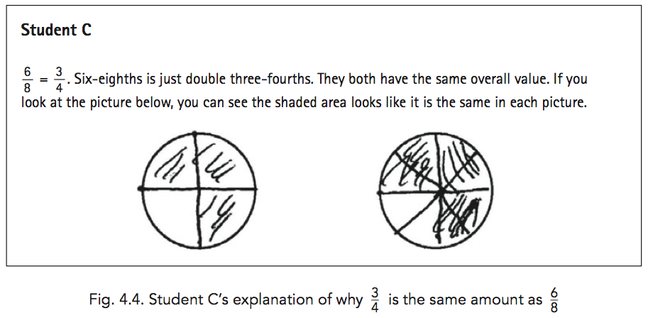
Knowledge of Learners

Slide 11
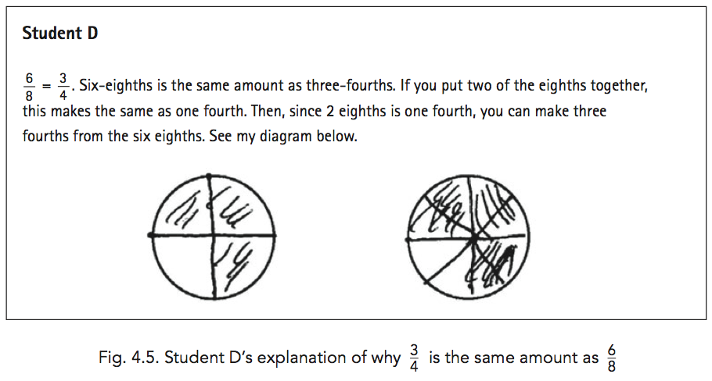
Knowledge of Learners

Slide 12
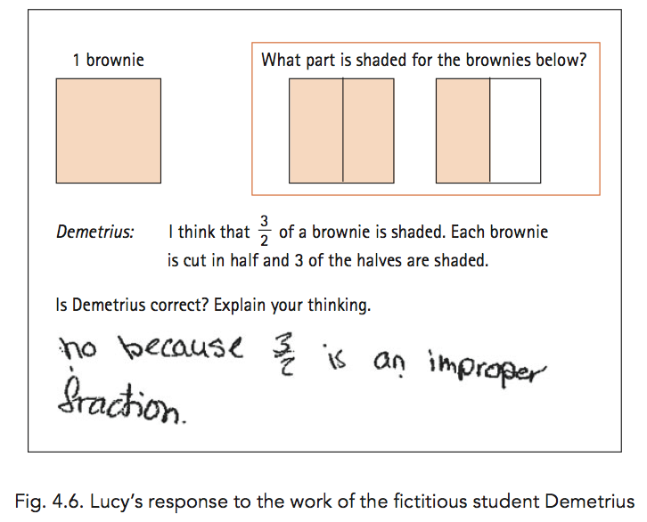
Knowledge of Learners

Slide 13
Knowledge of Learners
What aspects of students’ understanding of fractions are being assessed in the following tasks?
How do you think students would respond to these tasks?
Will the responses to the first task differ from the responses from the second task? If so, how? If not, why?

Slide 14
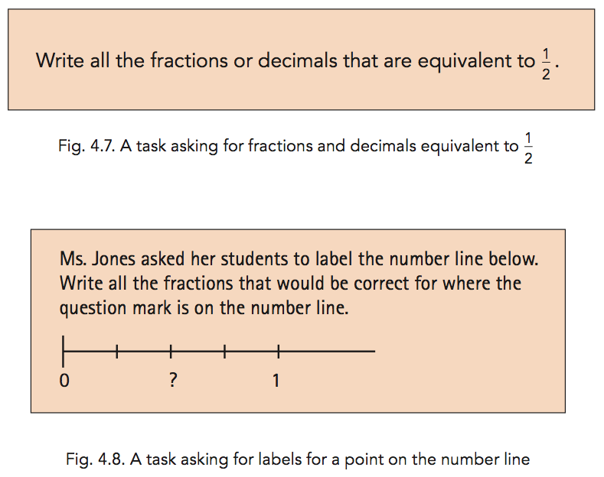
Knowledge of Learners

Slide 15
Knowledge of Learners
Compare your predictions with the following student responses.
Which students appear to have an understanding of equivalent fractions? What evidence can you cite to support these claims?
What misunderstandings do these students demonstrate related to equivalent fractions?

Slide 16
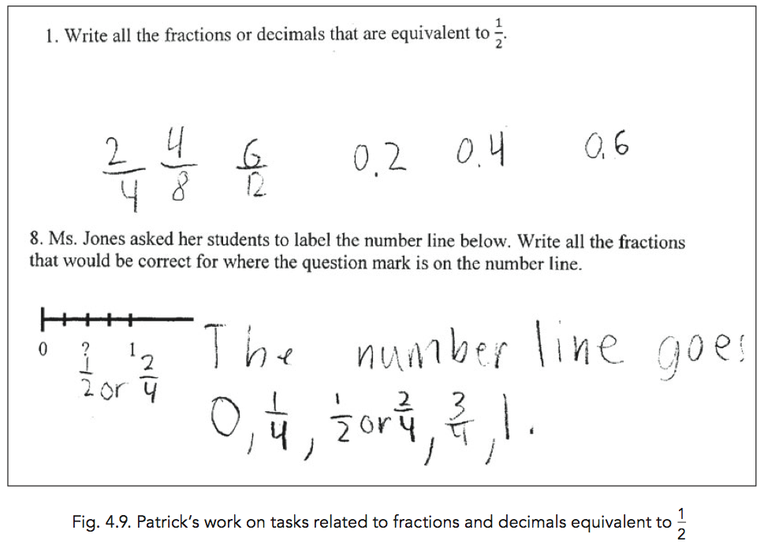
Knowledge of Learners

Slide 17
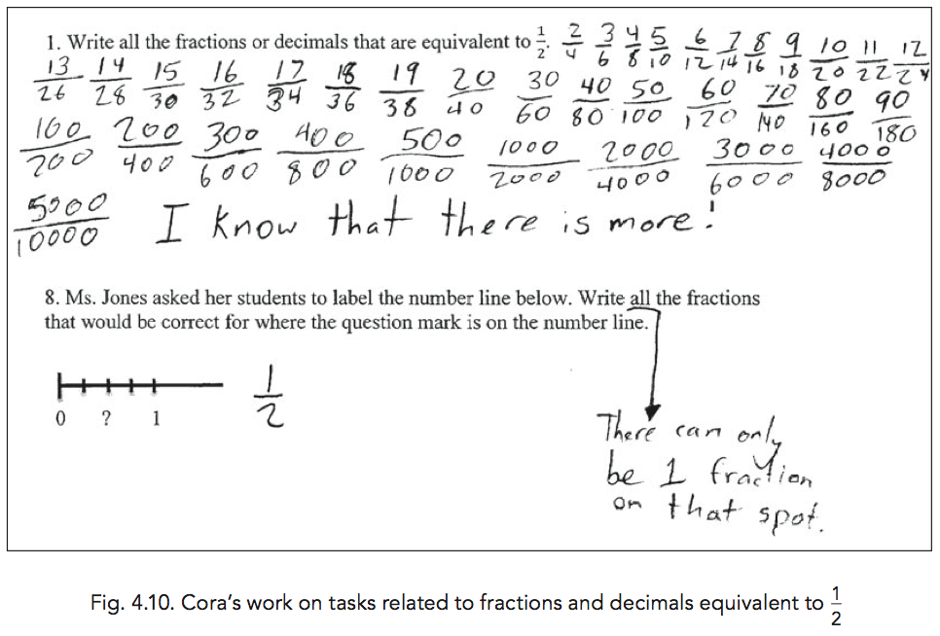
Knowledge of Learners

Slide 18
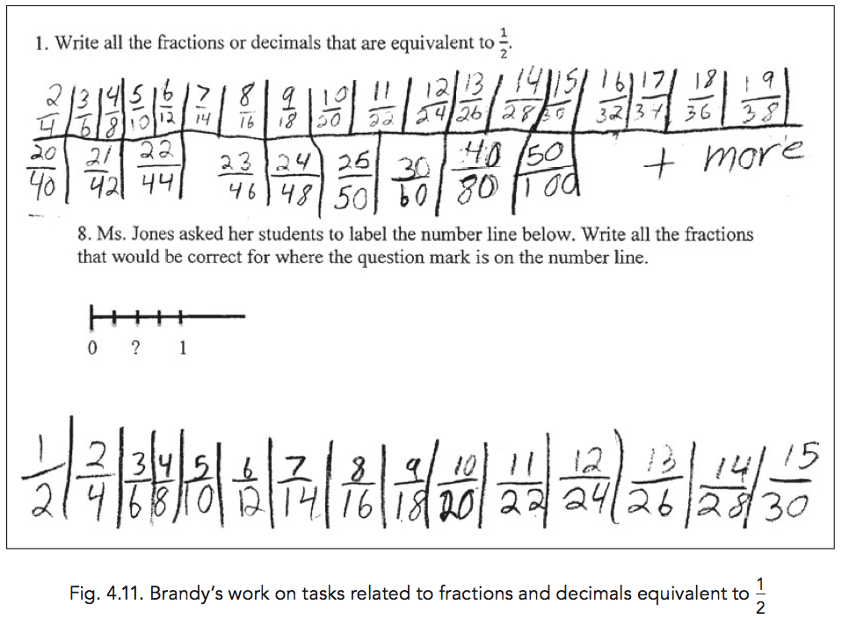
Knowledge of Learners

Slide 19
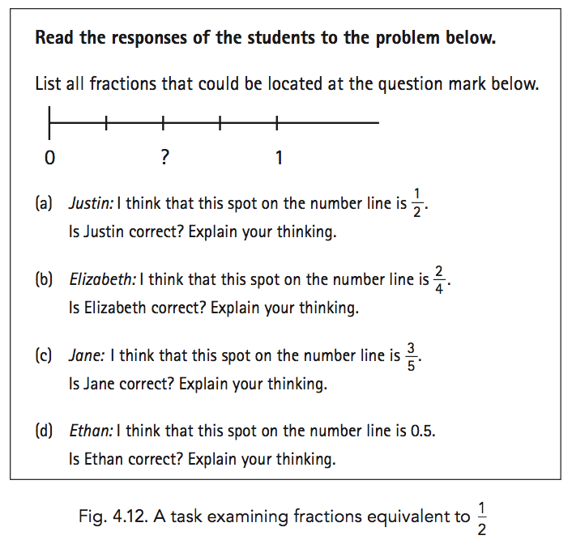
Knowledge of Learners

Slide 20
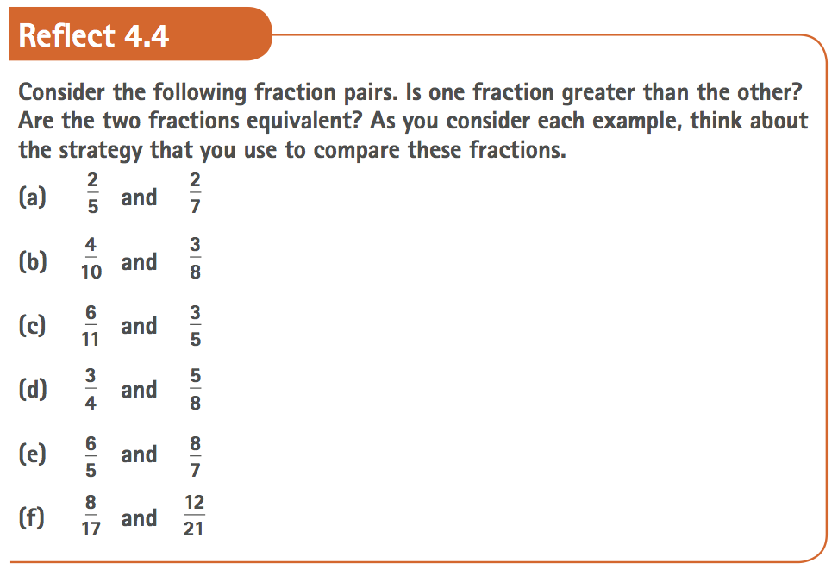
Knowledge of Learners

Slide 21
Knowledge of Curriculum
CCSSM encourages the use of three strategies for comparing fractions. Which of these three strategies do your curricular materials use? Which comparison problems suggest the use of a specific strategy?
An analysis of your materials can help you to determine which comparison problems to use and how to sequence them. For example, in the list of paired fractions in Reflect 4.4, problem (a) lends itself to the strategy of comparing numerators, problem (d) invites comparing denominators, and problem (c) is solved efficiently through the use of benchmarks.
The use of cross-multiplication, often presented as a procedure without understanding, is discouraged
(What about (-3)/(-4) > 1/2?)

Slide 22
Knowledge of Instructional Strategies
Encouraging students to work with physical models can reinforce their understanding of the importance of referring to the same unit when comparing fractions. For example, you might use different-sized candy bars (Snickers Bar, Snickers Miniatures, and Snickers Fun Size, for example) to help students understand the relationship between a fraction such as 1/2 and the reference unit as they compare 1/2 of the different bars. As students compare 1/2 of these different-sized candy bars, they should recognize that they could compare them in different ways (for instance, in terms of length or weight). Students will recognize that 1/2 of these different bars are not equivalent to one another, since the units differ.

Slide 23
Knowledge of Instructional Strategies
When the attribute used for the unit (for example, length) is not explicit, the language used in curricular tasks and in the classroom can present opportunities as well as challenges—especially for English language learners. “Equivalent” refers to the same value or amount. Thus, assuming that the unit is the same for both fractions, when you talk about equivalent fractions, you should use statements such as, “1/2 is equivalent to 2/4,” or “1/2 is the same amount as 2/4,” and avoid statements such as, “1/2 is the same as 2/4,” or “1/2 looks like 2/4.”

Slide 24
Knowledge of Instructional Strategies
What technology can be used to promote learning of equivalence and comparison of fractions.
Example: National Library of Virtual Manipulatives (Try “Comparing Fractions” or searching the site for “fractions”)

Slide 25
Knowledge of Assessment
Writing can help students develop mathematical concepts, and having your students write about mathematics can provide highly valuable access to their understanding

Slide 26
Knowledge of Assessment
Figures 4.2-4.5 presented the work of students A, B, C, and D, who were asked to write why 4/3 is the same amount as 6/8. This assessment task differs from a task such as, “Show that 4/3 is the same amount as 6/8.” It is important to help students develop writing competencies that are analogous to those that mathematicians use. Therefore, assessment tasks should require students not only to describe how they solved mathematics problems, but also to provide mathematical arguments, justify their thinking, and generalize beyond a small number of cases. Useful assessment questions include the following:
Why does this procedure work?
Will this strategy always work? And
How do you know?
These questions will not only help your students develop skill with different genres of mathematics writing, but also provide opportunities for you to assess their development of competency in using these genres.

Slide 27
Connecting Forward—Algebra
What elements of equivalence of fractions are important when learning equivalence of rational expressions such as
(x^2-1)/(x^2+x-2) and (x+1)/(x+2) ?
What is meant by equivalent expressions in this context?
What strategies might algebra students use to determine equivalence? Which of these have their foundation in equivalence of fractions?
What does it mean to say that one rational expression is greater than another?
(What about x/(x+1)>(x-1)/x?)

Slide 28
Resources for Rich Tasks
Carl's Long List
Illustrative Mathematics
Mathematics Assessment and Resource Service
Progressions
Hexagon Progression Map
NCTM Math Common Core Coalition
NCTM Illuminations
Connected Mathematics 3 (Student editions available on Amazon)
  Say it with Symbols

