Slide 1
Bhāskarācārya Ahead of his times 1114-1185
Avinash Sathaye
Professor of Mathematics
University of Kentucky
sathaye@uky.edu
Notes:
Trial note

Slide 2
Introduction to Zero
Idea of zero as a number.
Power of the right terminology. The model of money,
versus lengths of lines.
Creation of numbers: The whole universe of numbers, born out of nothing! Compare: The modern Peano axioms.

Slide 3
The concept of zero as a number
Idea of zero as a number is now established.
You can add/subtract/multiply using 0.
Why is it a no-no for division?

Slide 4
The contrasting disciplines
Geometry and analysis mainly tied down to the real world.
Algebra, the first bold adventure into the unknown.
My favorite quote to elementary algebra students who are afraid of “x”.
Bhaskara’s comment on Algebra: It is good for the dimwitted!!

Slide 5
पूर्वं प्रोक्तं व्यक्तम् अव्यक्तबीजम्
pūrvaṁ proktaṁ vyaktam avyaktabījam
प्रायः प्रश्ना नो विनाव्यक्त-युक्त्या।
prāyaḥ praśnā no vināvyakta yuktyā |
ज्ञातुं शक्या मन्दधीभिर्नितान्तम्
jñātuṁ śakyā mandadhībhirnitāntam
यस्मात् तस्मात् वच्मि बीजक्रियाम् च॥बीज. १.२
yasmāt tasmāt vacmi bījakriyām ca ||bīja. 1.2
We earlier discussed explicit (calculations),
which are rooted in the analysis of the indeterminate
(the unmanifested numbers). However, usually the problems cannot be solved completely without the trick of the indeterminates by people with weak intellect; so I will also explain the use of the indeterminates.

Slide 6
Types of Infinity
Real – reached by growing real numbers.
Ordinal – reached by higher and higher counts. Jain mathematicians Investigated this.
Cardinal – reached by measuring sizes of sets by comparing with each other. The modern Cantor Theory.

Slide 7
Basic Definitions about zero
वधादौ वियत् खस्य खं खेन घाते।
खहारो भवेत् खेन भक्तश्च राशिः॥बीज. २.१८
vadhādau viyat khasya khaṁ khena ghāte |
khahāro bhavet khena bhaktaśca rāśiḥ ||bīja. 2.18
A zero results when a number is multiplied by zero, and when divided by zero, it becomes kha-hara (with zero denominator).

Slide 8
Basic Definitions 2
योगे खं क्षेपसमं वर्गादौ खं खभाजितो राशिः।
खहरः स्यात् खगुणः खं खगुणश्चिन्त्यश्च शेषविधौ॥लीला. ४६
yoge khaṁ kṣepasamaṁ vargādau khaṁ khabhājito rāśiḥ |
khaharaḥ syāt khaguṇaḥ khaṁ khaguṇaścintyaśca śeṣavidhau ||līlā. 46
Zero plus (or minus) zero is zero and its square is zero. Number divided by zero becomes kha-hara and multiplied by zero is zero; but this khaguna should be paid attention to during remaining processes.

Slide 9
Definitions Continued
शून्ये गुणके जाते खं हारश्चेत् पुनस्तदा राशिः।
अविकृत एव ज्ञेयस्तथैव खेनोनितश्च युतः॥लीला.४७
śūnye guṇake jāte khaṁ hāraścet punastadā rāśiḥ |
avikṛta eva jñeyastathaiva khenonitaśca yutaḥ ||līlā.47
When zero becomes a multiplier and again a divisor later, then the number should be considered unchanged, as also when added or reduced by zero.

Slide 10
Special algebraic terms!
Effectively, Bhaskaracharya is creating two new algebraic objects called
khahara (खहर )and khaguṇa (खगुण).
These go back to Brahmagupta as well, but they were not elaborated as clearly with discussions and examples as by Bhaskaracharya.

Slide 11
The Khahara
For khahara, he gives a graphic description:
अस्मिन् विकारः खहरे न राशावपि प्रविष्टेष्वपि निःसृतेषु।
बहुष्वपि स्यात् लयसृष्टिकालेऽनन्तेऽच्युते भूतगणेषु यद्वत्॥ बीज.२.२०
asmin vikāraḥ khahare na rāśāvapi praviṣṭeṣvapi niḥsṛteṣu |
bahuṣvapi syāt layasṛṣṭikāle'nante'cyute bhūtagaṇeṣu yadvat|| bīja.2.20
There is no variation in this khahara (by adding or subtracting numbers) just as the infinite stable Brahma is not affected by numerous living beings entering or leaving it at the time of dissolution or creation of the worlds.

Slide 12
Our Plan
We shall now set up some formal notation and discuss three exercises created by Bhaskaracharya. The first of these is explained as an introduction of limits, a precursor to Calculus. The other two, however, are often described as a blemish on the otherwise great work of Bhaskaracharya.
We propose to give a new justification of these exercises.

Slide 13
A modern Formulation

Slide 14
More Properties

Slide 15
Ramanujan Interlude
A conversation with Ramanujan as reported by Mahalanobis.
Zero represents the absolute (nirguna brahma).
Infinity is the totality of all possibilities capable of being manifest.
The product of zero and infinity would thus supply the whole set of finite numbers!

Slide 16
The First Problem
(1.1) What is 0 plus 5, what are the square and square roots of 0? Cube and cube root, (what is ) 5 times 0?
(1.2) What is 10 divided by zero?

Slide 17
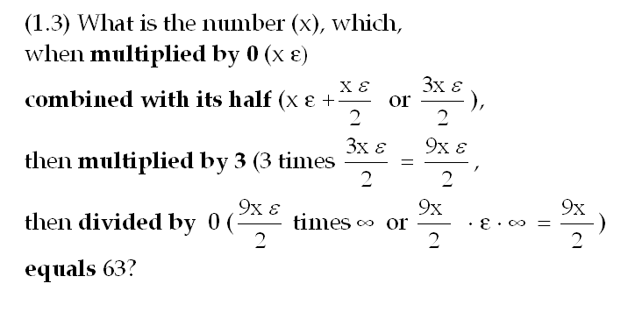
Problem 1 Continued

Slide 18
Motivation
Old and modern commentators explain the process as a limiting process.
The multiplier zero and divisor zero can be both imagined as quantities approaching zero at the same rate, so the limit of their ratio is 1.
Indeed Bhaskaracharya certainly had ideas of such limiting processes and is known to have figured out what we may describe as d(sin(x)) = cos(x)dx.

Slide 19
Problem 2
What is the number (x) divided by zero (x∞), augmented or reduced by 10,000,000 (x∞±10,000,000), still (x∞) by the winning rule, squared x²∞ augmented by its own root x²∞+ x∞ =(x²+x)∞
And multiplied by 0 becomes 90
i.e. 0(x²+x)∞ =(x²+x)=90?

Slide 20
Problem 2 Continued
If you interpret this by the limiting process, you would get the left hand side going to infinity and not to the expression
X²+x and hence Bhaskaracharya is criticized.
However, his main rule that ∞∞= ∞ makes it work!!

Slide 21
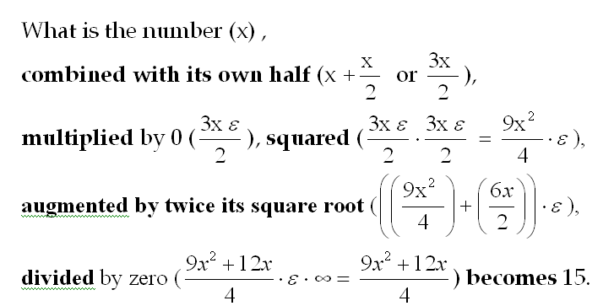
Problem 3

Slide 22
Problem 3 Continued.
The criticism and the solution are just as before!

Slide 23
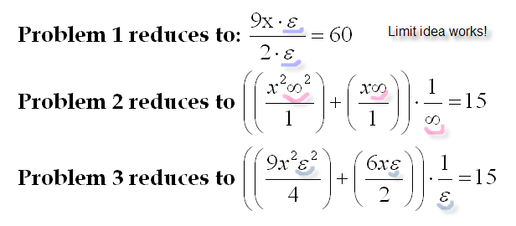
Final Equations.

Slide 24
Final Conclusions.
In modern Mathematics, people have found numerous techniques to accommodate infinity.
The projective geometry adds a whole line at infinity to the usual plane. For the real line, it associates only one point at infinity – same on the positive or negative side.
In Complex Analysis, it is customary to add a single infinite point for the whole plane, making the Riemann Sphere. However, unlike Bhaskaracharya, it does not make an idempotent!

Slide 25
Final Conclusions continued.
In Modern Algebra, the localization process does allow zero (or something which behaves like it, namely a zero divisor) in the denominator. But the resulting fraction is reduced to zero. This is like Brahmaguptas declaration of 0/0=0. However, it does not produce the rich structure of Bhaskaracharya.
In the development of Calculus, the infinitesimals were quantities which have the dual nature of being non zero during calculations but zero at the end. As suggested the first problem fits this idea.

Slide 26
Final Conclusions continued.
But, as explained, the added infinity which is an idempotent is a very different idea.
The closest analog of this idea can be seen in the theory of valuations. For valuations of rank one, it is customary to add an infinity to the field which has the property of idempotence. Valuations of higher rank even produces higher and higher infinities with enhanced winning rules.
Naturally, such details are best left for a written document!

Slide 27
Dedicated to
Bhaskaracharya
[1114-1185]
In celebration of
his 900th birth year.

